Slide 1
Homework #1
Mady by
Petr Yakovlev
Alia Rachimkulova
Akram Turakulov
Julia Sitdikova

Slide 2
TABLE OF CONTENTS
01
DATASET EXPLORATION
03
COHORT ANALYSIS
02
CLUSTER ANALYSIS
04
RFM AND MARKETING STRATEGIES

Slide 3
DATA EXPLORATION

Slide 4
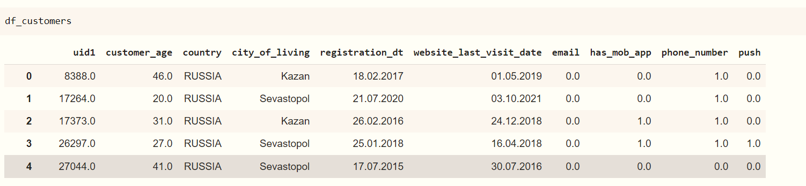
DATASET EXPLORATION

Slide 5
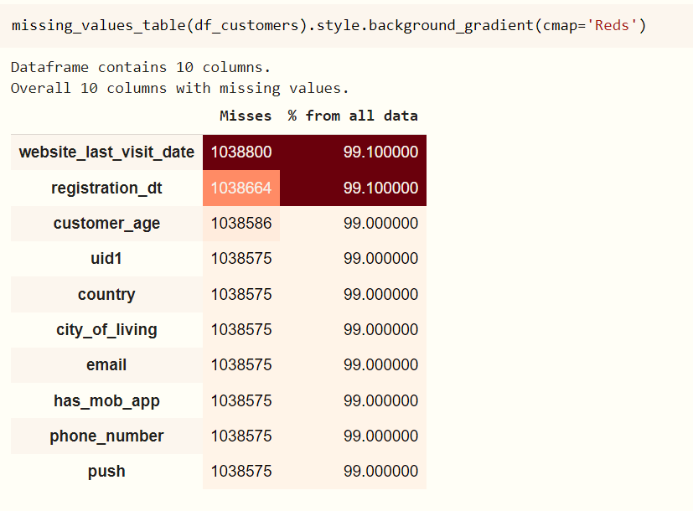
Checking missing values

Slide 6
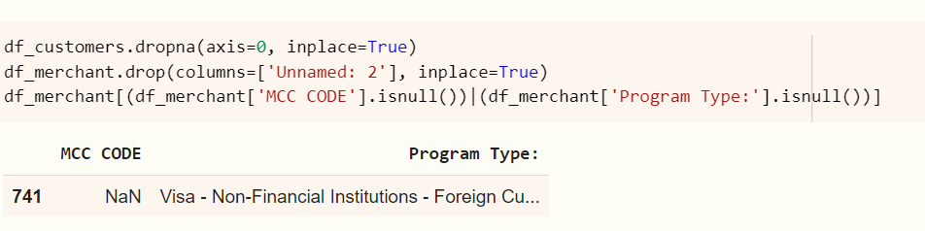
Dropping unnecessary columns

Slide 7
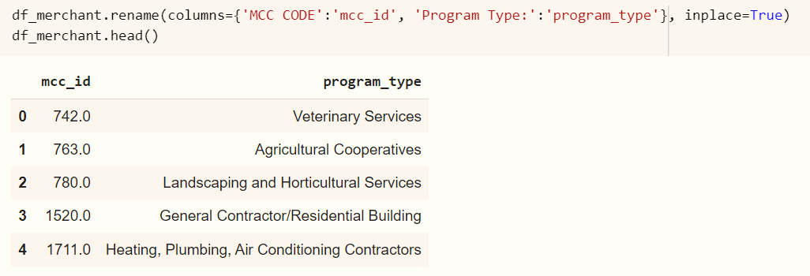
Dropping unnecessary columns

Slide 8
Renaming columns

Slide 9
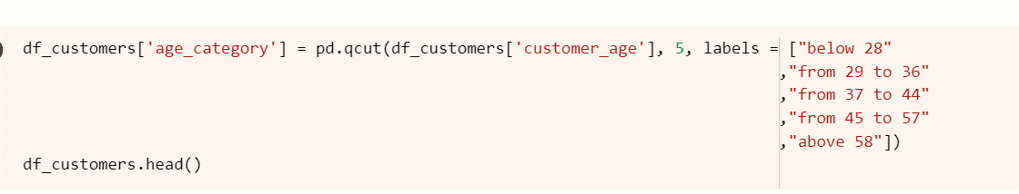
Dividing by age category

Slide 10
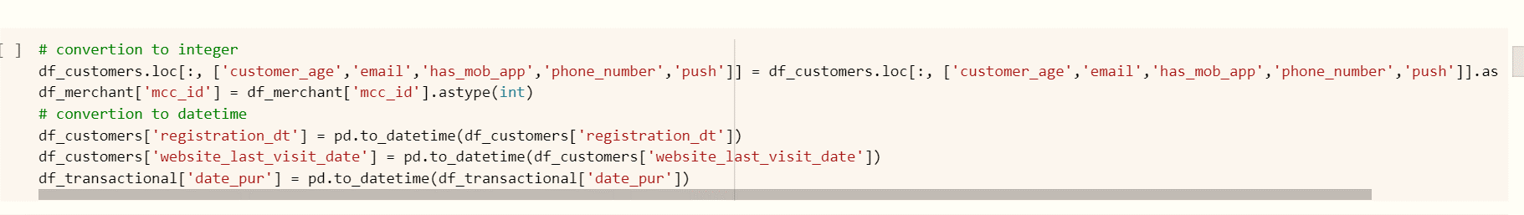
Dividing by age category, data type conversion

Slide 11
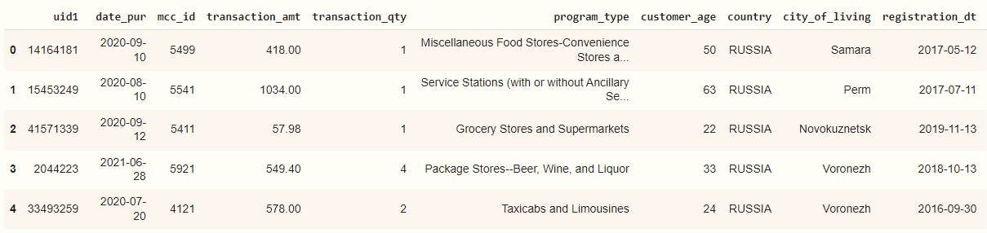
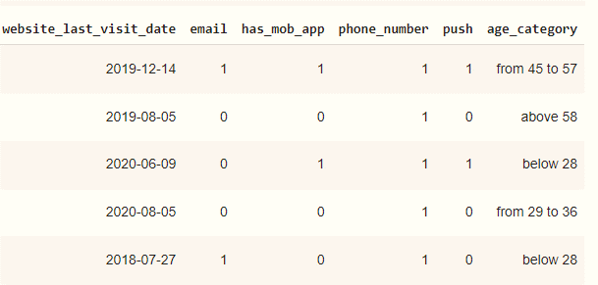
Merging dataframes
After merging datasets, we see a lot of useful features necessary for further analysis: cohort, rfm, and so on.
For example, this is the date of purchase of the user, the number of transactions, transaction_amt.
Also, the presence of various channels of work with the user: email, phone_number, push are required for further work on the promoting strategy.
Also we added age_category of our clients which represents quantiles for deep understanding

Slide 12
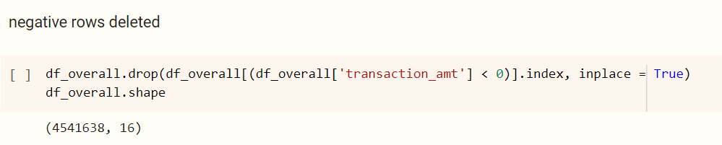
Deleting negative rows

Slide 13
Cohort analysis

Slide 14
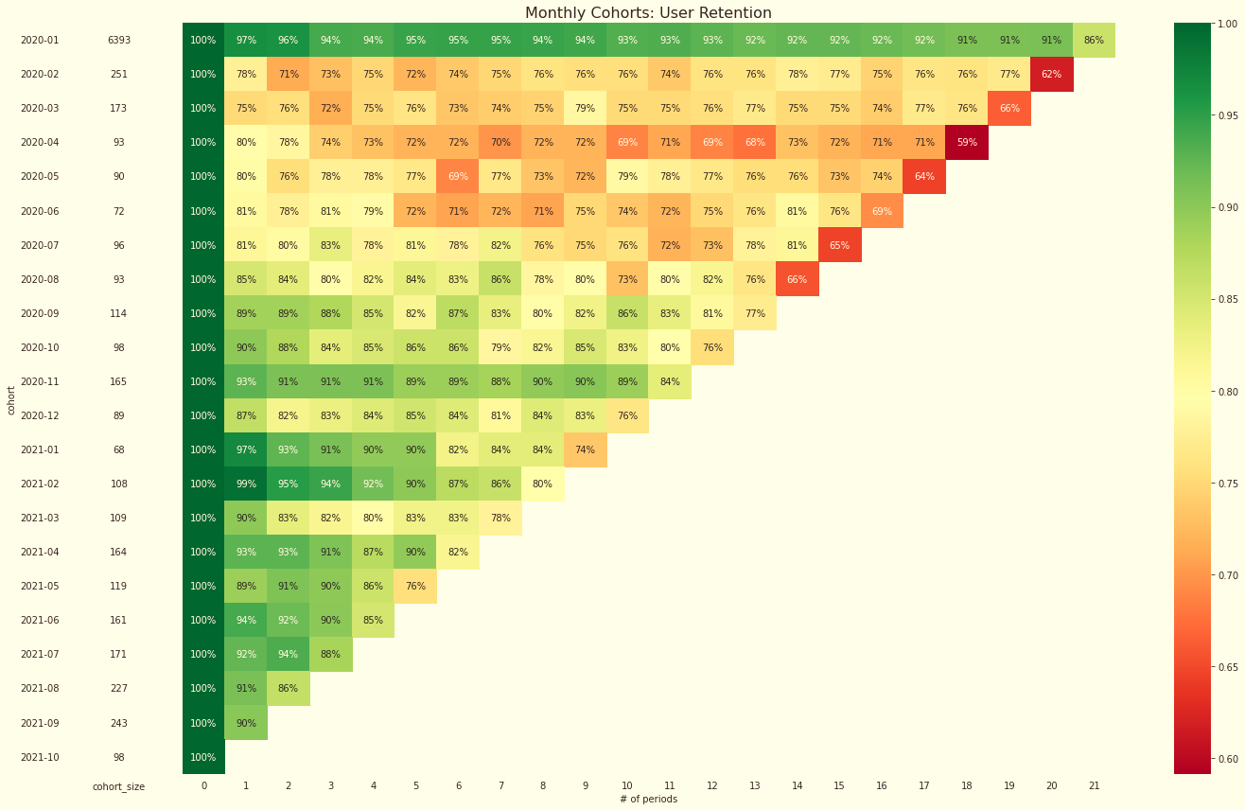
Cohorts analysis
Key points:
The first cohort (2020–01) seems to perform surprisingly well compared to the other. A year after the first purchase, there is more than 70% retention rate. This might be a cohort of dedicated customers, who first became clients based on some already-existing connections with the company
We observe overall good retention rate across all cohorts, after 1 year there are no rates below 50%, however we can see fluctuations in retention over time.
Customers acquired since the cohort from 2020-04 to 2020-07 are less likely to return, which company should take into consideration

Slide 15
RFM

Slide 16
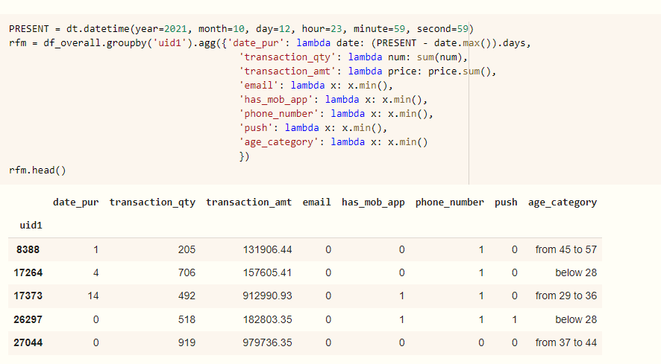
RFM
We implemented RFM in order to divide customers into various categories or clusters to identify customers who are more likely to respond to promotions and also for future personalization services. Also we added some additional attributes

Slide 17
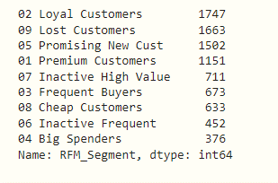
Also we create customer’s groups and segmented them into these categories

Slide 18
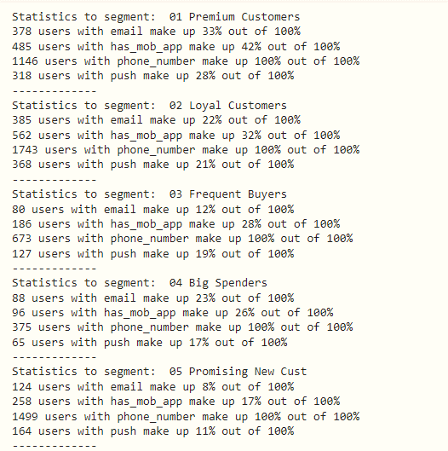
Also we calculated some statics according to certain clients segments

Slide 19
CLUSTER ANALYSIS

Slide 20
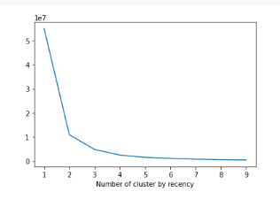
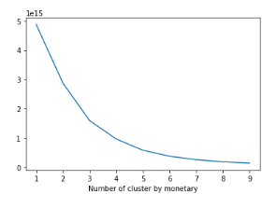
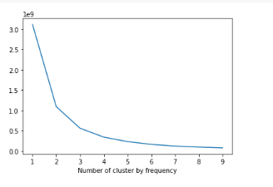
Finding Optimum Clusters
Before scaling we decided find optimum number of clusters sequentially going through features: recency, monetary, frequency

Slide 21
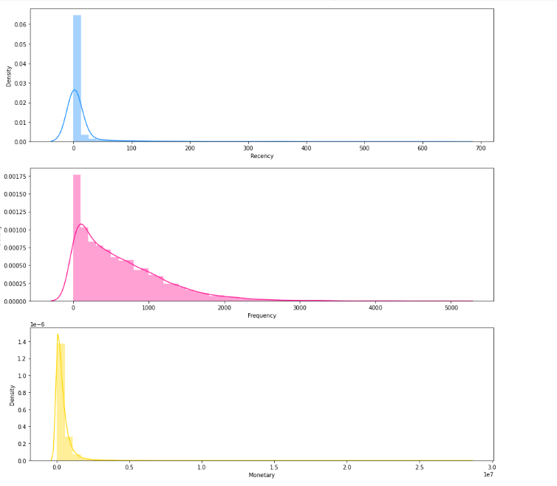
Observing distributions
Here we can observe that the data is highly skewed. So we have to transform and scale the data first because K-Means assumes that the variables should have a symmetric distributions(not skewed) and they should have same average values as well as same variance

Slide 22
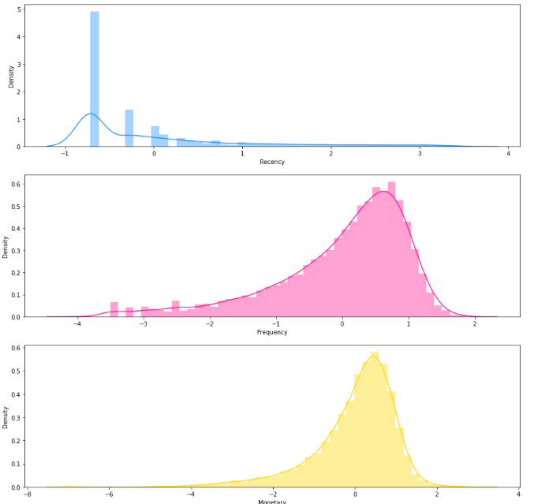
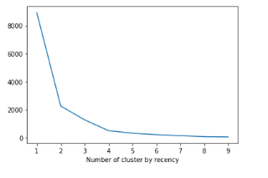
Finding Optimum Clusters using scaled data
We scaled our data.. Lets try to find number of appropriate clusters to divide customers with elbow method.

Slide 23
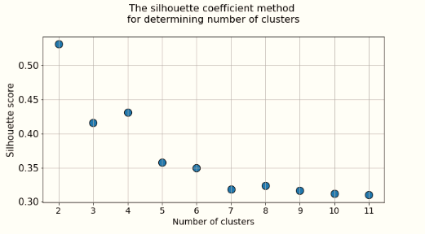
Finding Optimum Clusters using scaled data
From the elbow graph, it seems that good number of cluster would be 3 as after that, its a smooth curve i.e. no change of orientation. But to overcome that confusion, we will use silhouette score method to find the optimum number of clusters because it is often much better in figuring out the number of valid clusters than the elbow method

Slide 24
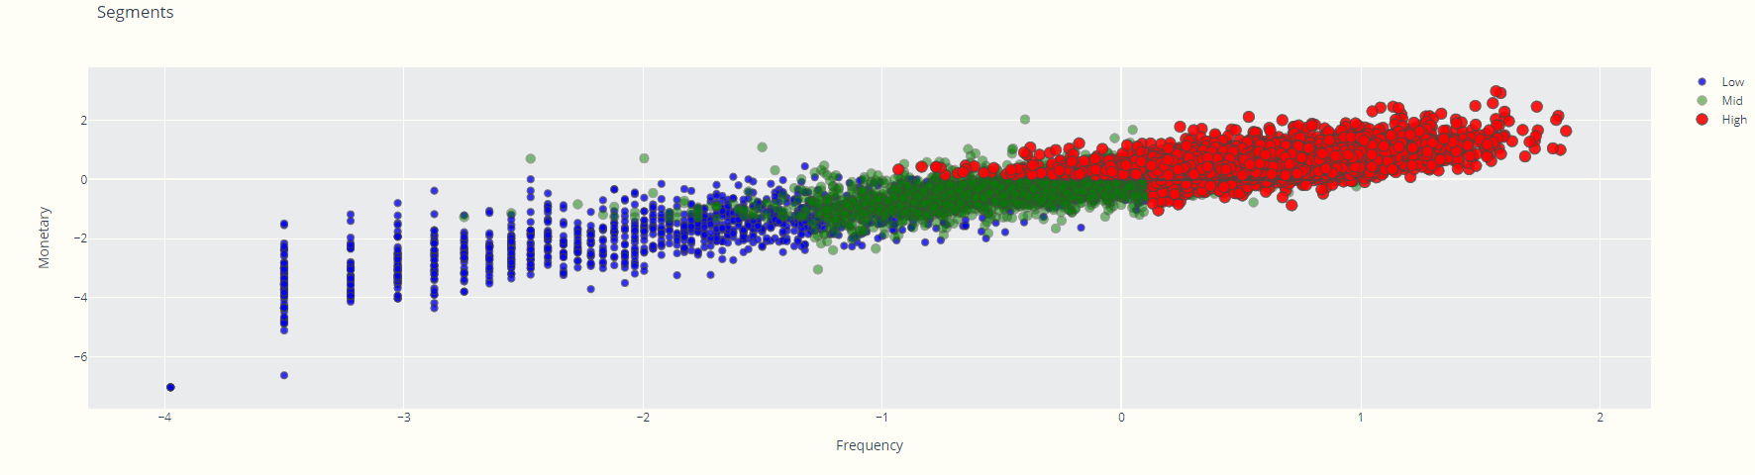
CLUSTER ANALYSIS

Slide 25
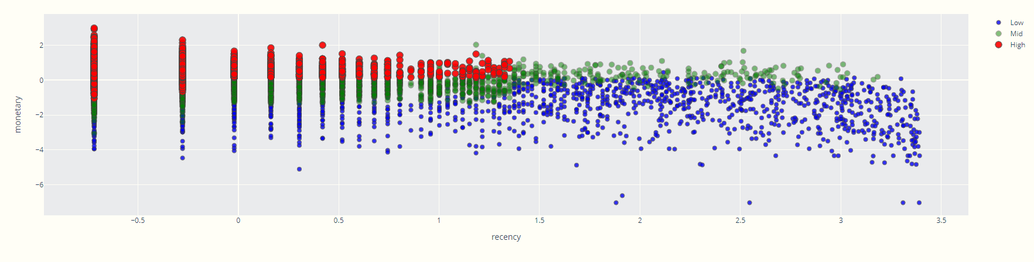
CLUSTER ANALYSIS

Slide 26
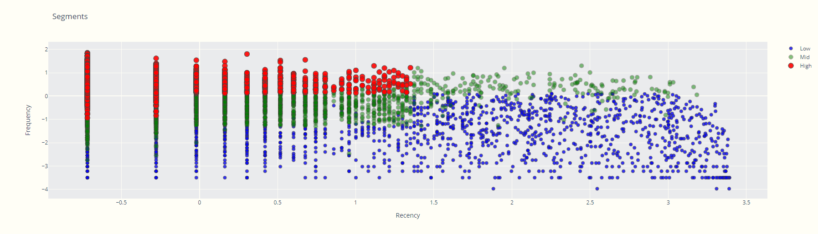
CLUSTER ANALYSIS

Slide 27
Interpretation of cluster analysis
Customers in “High” cluster: they have the highest frequency and monetary ratio and monetary with low recency ratio. Looking at other diagrams we can see that they also have low recency with high frequency ratio. These are our most valuable customers for us.
Customers in “Mid” cluster represent similar shopping pattern like cluster “High” but on an average less value for each attributes. These are the loyal customers.
Customers in “Low” cluster they show lower frequency, monetary as well as high recency rates. They are most sleepy and unprofitable customers for us. Some of them are more likely to respond to a campaign and has the potential to turn profitable.

Slide 28
KPIs
Frequency of purchases
MAU
Revenue
Increase of activity from “sleepy” segments
Increase of frequency from “sleepy” segments
Increase of revenue from “sleepy” segments

Slide 29
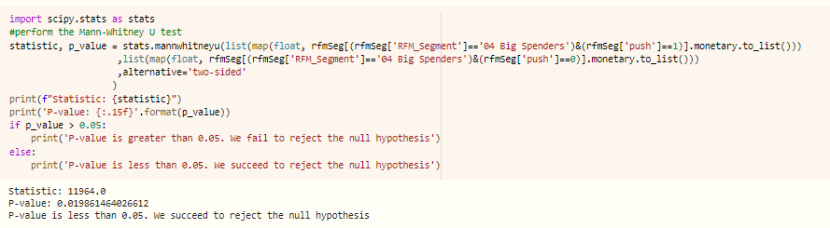
HYPOTHESIS TESTING
01
Big spenders’ behavior in terms of spending is statistically different for those who has push communication channel
The null hypothesis cannot be accepted, which means that even though the buyers in the Big spenders cluster tend to spend more, an extra push can bring additional results
02
Big spenders’ behavior in terms of frequency is statistically different for those who has push communication channel
The null hypothesis cannot be rejected, which means that an extra push cannot facilitate more frequent buying

Slide 30
HYPOTHESIS TESTING
03
Big spenders’ behavior in terms of spending is statistically different for those who has email communication channel
The null hypothesis cannot be accepted, which means that even though the buyers in the Big spenders cluster tend to spend more, an extra email can bring additional results
04
In the Big spenders segment, there are differences in the level of spending by age groups
None of the tests gave grounds for rejecting the null hypothesis, which means that there is no age correlation within the Big spenders segment

Slide 31
HYPOTHESIS TESTING
05
Big spenders’ behavior in terms of spending is statistically different for those who has email communication channel
The null hypothesis cannot be accepted, which means that even though the buyers in the Big spenders cluster tend to spend more, an extra email can bring additional results
06
There are differences in the level of spending by age groups across customers who spend infrequently
There are differences in the frequency of purchases by age groups across customers who spend infrequently
Age has a significant statistical effect (even at the 1% significance level) when estimating the number of purchases

Slide 32
HYPOTHESIS TESTING
Individuals who might have accumulated a significant amount of wealth. They spend large amounts of money to live a good lifestyle. Due to their large spending capacity, these individuals are likely to be looking for properties to buy or invest in. They are also more likely than all other segments to take out housing loans and make serious financial commitments.
!
07
Customers from Inactive high segment are somewhat differentiated by availability of push and email channels
As expected, wealthy people from this segment are not very receptive to the classic promotion option through push or email. Accordingly, it hardly makes sense to incur additional costs for a promo for this segment

Slide 33
HYPOTHESIS TESTING
08
The presence of email notifications and push notifications affects the decision of the outgoing buyer to purchase
Enhanced communication via email or push may deter a customer from completely abandoning services/products, but will not contribute to a significant increase in spending
09
The presence of email notifications and push notifications affects the decision of the cheap customer to purchase
However, such communication for cheap customers can help increase the amount of spending. Accordingly, it is reasonable to redistribute part of the investment in advertising from almost gone buyers to advertising for cheap customers

Slide 34
HYPOTHESIS TESTING
10
The availability of mobile application communication has a statistically significant effect on monetary value of potential buyers
The communication via the mobile app might be highly effective when working with group of potential buyers
11
The availability of email / push communication has a statistically significant effect on monetary value of potential buyers
The communication via the email and push also might be highly effective when working with group of potential buyers
!
According to the available data, potential buyers group consist of high amount of younger age group

Slide 35
HYPOTHESIS TESTING
12
Availability of email and push marketing communication have statistical effect on the amount of spending in the cluster of Frequent buyers
We fail to reject null hypothesis, therefore the communication via emails and push might be not effective in the group of frequent buyers
13
Age has significant effect to the monetary aspect of purchases for this cluster (Frequent buyers)
The communication via the email and push also might be highly effective when working with group of potential buyers
!
We can see that the group of frequent buyers are represented with high proportion of younger age customers. Here the aim is to increase the value of purchase

Slide 36
HYPOTHESIS TESTING
14
The availability of communication channels has significant statistical effect on the monetary value and frequency of purchases of Premium customers
It is possible to use the main communication channels to increase the spending of premium customers, but the availability of communication channels does not significantly affect the frequency of purchases

Slide 37
RFM: CUSTOMER SEGMENTATION
Loyal Customers
Lost Customers
Promising New Cust
Premium Customers
Inactive High Value
Frequent Buyers
Cheap Customers
Inactive Frequent
Big Spenders

Slide 38
MARKETING STRATEGIES
Premium Customers
Highly engaged customers who have bought the most recent, the most often, and generated the most revenue.
Customers who Buy on a regular basis and on average prices
Customers who have generated the most revenue for your store
Loyal Customers
Big Spenders
Loyalty programs, golden card
New product introduction
Thank-you letter
Early access to the new collection
Access to limited event
Special care
(no discount offers)
Priced Bundling
Loyalty programs
Advocacy programs and reviews
Free Shipping and other benefits
New Product & Priced Bundling
Smart content/product recommendations
(no discount offers)

Slide 39
MARKETING STRATEGIES
Promising New Customers
First time buyers
Customers who buy really often
Past customers who spend a lot but haven't bought in awhile.
Frequent Buyers
Inactive High Value
Point Rewards Sale
Thank-you letter
Welcome gift
Early access to the new collection
Mixed Bundling & Discount
Sale on expensive products
Returning Offers
Discount Sale
New Product offer
Exclusive product offer

Slide 40
MARKETING STRATEGIES
Inactive Frequent
Used to purchase frequently but haven’t returned for a long time.
Last purchase long ago, purchased few and spend little
Last purchase was very long time ago, purchased few and spend very little.
Cheap Customers
Lost Customers
New Product offer/free trial period
Alert about sales and special promotions
Aggressive Discount
Don't bother to require

